Slide 1


SmartHire
AI-Powered Resume & Job Matching System
NLP Project - CS3126
Pradham • Abhivarun •Laasya • Akshitha • Lohith

Slide 2



The Problem
Volume Overload: Companies receive hundreds of resumes for a single open position.
Time Constraint: HR teams lack the bandwidth to read every resume thoroughly.
Flawed Filters: Basic keyword search misses good candidates who use different terminology.
Inconsistency: Manual screening is slow, tiring, and prone to human error.

Slide 3








SmartHire Pipeline
1. Ingest
2. Parse
3. Score
4. Rank
Read Job Description and Resume files (PDF/Docx).
Extract skills, education, and experience; clean text.
Calculate match metrics across 5 key categories.
Generate final fit score (0-100) and sort candidates.

Slide 4



Data Extraction
Candidate Resume
Job Profile
Input: PDF / Word Files
Input: PDF Description
•
Skills & Tools mentioned
•
Required Skills (e.g., AWS, Python)
•
Work History & Duration
•
Years of Experience
•
Degrees & Universities
•
Education Requirements
•
Certifications obtained
•
Certifications

Slide 5
Scoring Components
Skill Match: Ratio of candidate skills to required job skills (e.g., 3/7 match).
Experience Alignment: Checks if total years meet the minimum requirement (1.0 = meets/exceeds).
Education Match: Verifies if degrees and fields of study align with the role.
Certifications: Checks for specific required professional certificates.
Semantic Similarity: Uses NLP embeddings to measure how similar the resume text is to the JD overall.

Slide 6
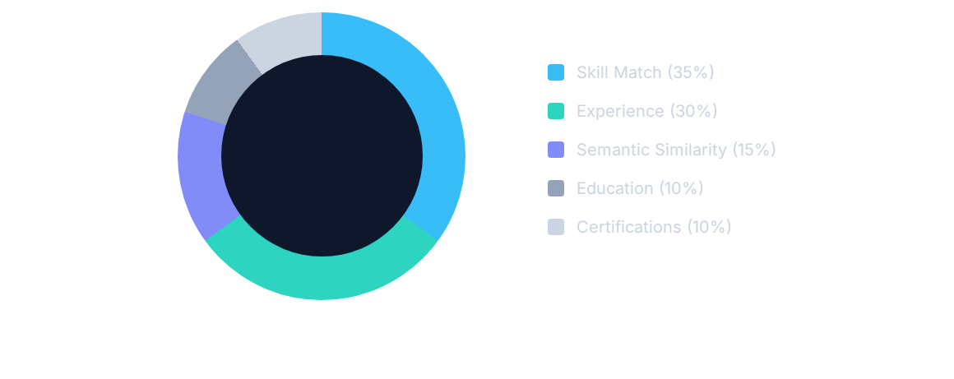
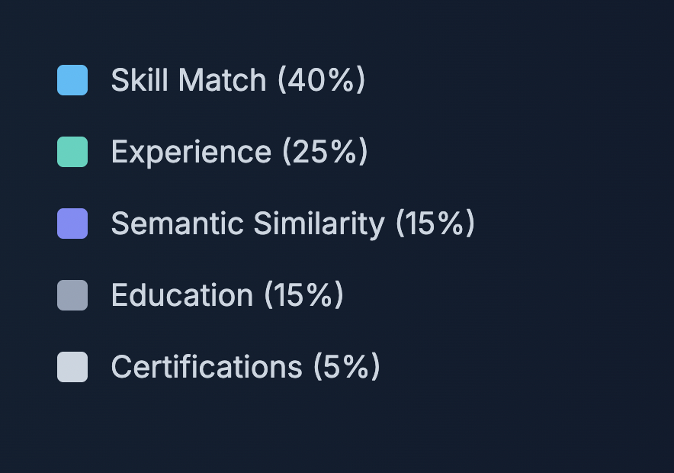
Weight Distribution
"Skill match and experience are given the highest importance."

Slide 7



Output: Candidate Profile
Candidate 1
Fit Score: 59.39 / 100
Matched: AWS, Git, NoSQL, SQL
Missing: Docker, Kubernetes, Python
"Strong skill overlap (57%). Experience appears below required level. Education matches requirements."

Slide 8
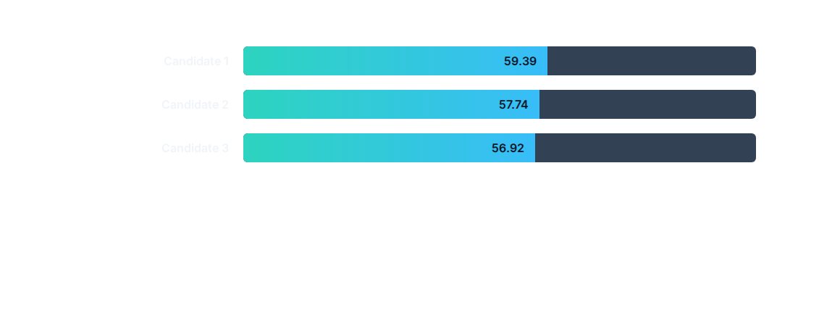

Candidate Comparison
Insight: Top candidates often have similar scores but different skill gaps. Candidate 2 is stronger on Python but weaker on Git/Kubernetes compared to Candidate 1.

Slide 9






Benefits for HR
Ranked Lists
Deep Insights
Efficiency
Instantly see the top 5-10 resumes instead of reading hundreds.
See exactly which skills are matched vs. missing at a glance.
Drastically reduces screening time while keeping the "human in the loop".

Slide 10
Team Contributions
Pradham
Project Management
Abhivarun
Matching & Scoring
Laasya
Integration & CLI
Akshitha
Parsing & Preprocessing
Lohith
Testing & Output

Slide 11

Conclusion
SmartHire automates the initial screening bottleneck by reading resumes like a human would—focusing on context, skills, and experience rather than just keywords.
Key Outcome: A transparent, consistent, and efficient scoring system that empowers HR to make better hiring decisions faster.
Consistent Ranking
Transparent Scoring
Human-Centric AI

